Slide 1
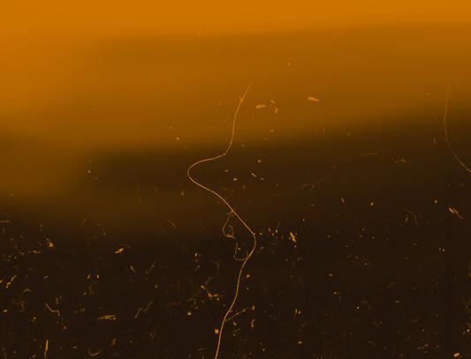
MAJOR PROJECT EmbedroW
(Tensor Visualisation Tool Extension with In-Explicit Embedding.)
Under the guidance of PROF. SUHAS BHISE
Group Sr. No. : BT-75
Name : Shreyash Bhatkar
Roll no. : 48 (ET – A)
Gr. no. : 11910751

Slide 2
ABOUT
A t-SNE projector for higher dimensional data and word embeddings
This project is a tool to setup and utilize the standalone version of Tensorflow Embedding Projector.
Example : It shows how a pretrained InceptionV3 model can be used on images and plotted in an interactive 3d map.
Update 2020
The embedding project has been updated by Google to support new features, among which is the support for UMAP.
Why this over the Standalone Projector?
This project allows you to visualize any array of vectors with a light decency stack. It is designed to be decoupled from any library. Moreover , it uses a static file system, so you can publish your results without requiring a server.

Slide 3
TABLE OF CONTENTS
01.
02.
03.
04.
OVERVIEW
INSTALLATION
REQUIREMENTS
DEMONSTRATION
05.
RESULTS AND CONCLUSION

Slide 4
01.
THE OVERVIEW
This section contains the usage and gist of the project.

Slide 5
Overview
Principal Component Analysis (PCA)
PCA is an exploratory tool used that is generally used to simplify a large and complex dataset into a smaller, more easily understandable dataset. It achieves this by doing an orthogonal linear transformation that transforms data into a new coordinate system arranged by their variance content in the form of principal components i.e. your higher dimensional correlated data is projected into a smaller space that has linearly independent bases.
CRUX
CORVUS
CYGNUS

Slide 6
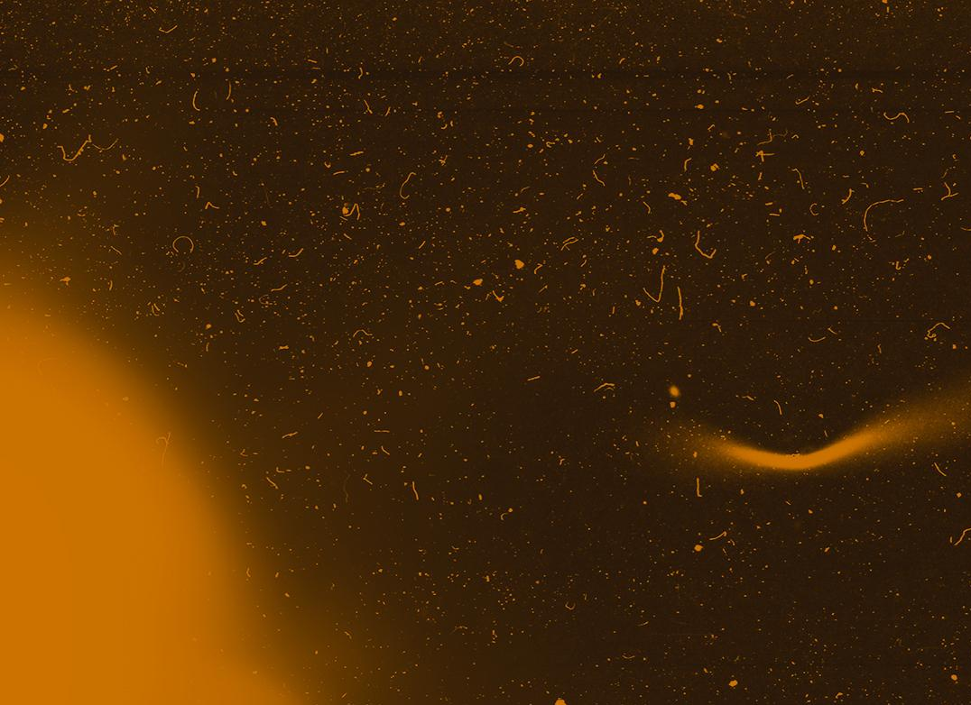
T-SNE
t-SNE is a powerful visualization technique that can help to find patterns in data in lower-dimensional spaces. It is a non-linear dimensionality reduction technique. However, unlike PCA it involves an iterative optimization which takes time to converge and there are a few parameters that can be tweaked. There are two major steps involved.

Slide 7
TOOLS AND TECHNOLOGIES
Tensorflow
ScikitLearn
Keras
Python3
numpy
Anaconda.(For virtual environment)
HTML

Slide 8
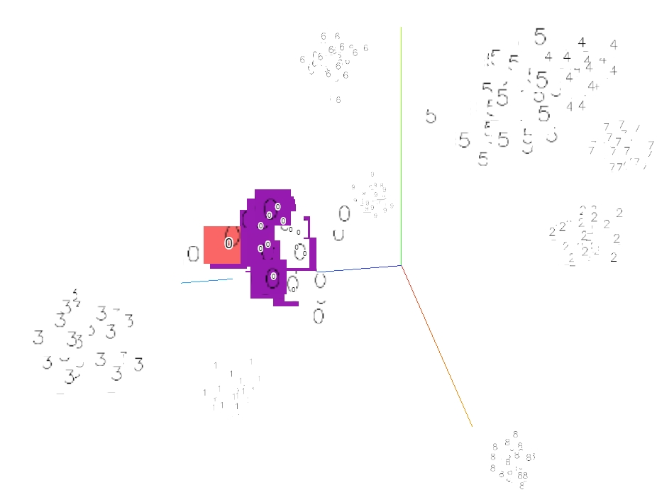
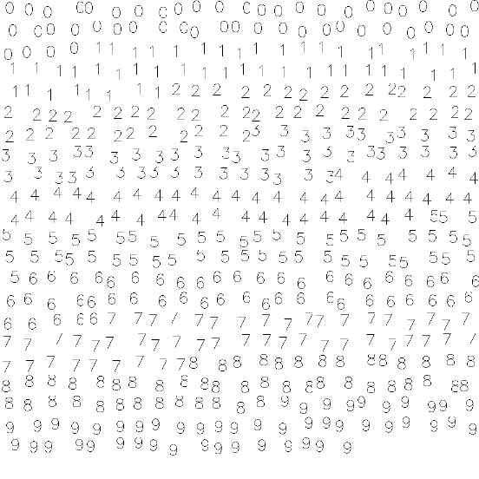
Examples :
Tensorflow
ScikitLearn
Keras
Python3
numpy

Slide 9
Examples :
Tensorflow
ScikitLearn
Keras
Python3
numpy

Slide 10
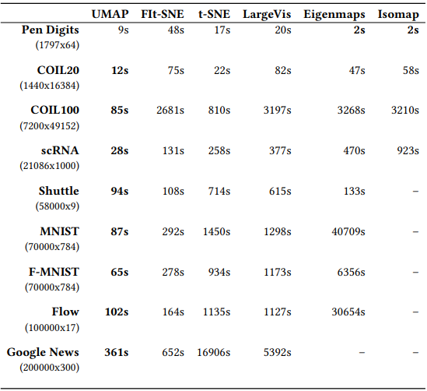
Results from t-SNE, UMAP & PCA.
Description: The execution time of various dimension reduction techniques on diverse datasets. Some datasets were subsampled or had their dimension decreased by PCA to allow a larger range of algorithms to operate on them. The Flow Cytometry dataset was tested using a 10% sample, and GoogleNews was subsampled as much as 200,000 data points. Finally, PCA was used to compress the Mouse scRNA dataset to 1,000 dimensions. The quickest runtime for each dataset is highlighted.

Slide 11
Conclusions and Future Work
While we can observe UMAP is an excellent approach for both visualisation and dimension reduction, most algorithms, including UMAP, must make trade-offs.
In this part, we have covered in detail the regions or use cases where UMAP is less effective, as well as viable alternatives.
The interpretability of the reduced dimension output is crucial for a variety of application cases.
UMAP, like most non-linear dimension reduction approaches (including t-SNE and Isomap), lacks the strong interpretability of PCA and related techniques like as Non-Negative Matrix Factorization (NMF).

Slide 12
References
[1] H. Chernoff. The use of faces to represent points in k-dimensional space graphically. Journal of the American Statistical Association, 68:361–368, 1973.
[2] J.A. Cook, I. Sutskever, A. Mnih, and G.E. Hinton. Visualizing similarity data with a mixture of maps. InProceedingsof the 11th International Conference on Artificial Intelligence and Statistics, volume 2, pages 67–74, 2007.
[3] L. Grady. Random walks for image segmentation. IEEE Transactions on Pattern Analysis and Machine Intelligence, 28(11):1768–1783, 2006.
(Rest mentioned in IEEE paper)

Slide 13
“THANK YOU FOR YOUR TIME!”

